Slide 1
Python Programming
MySQL connection
Anisha P Rodrigues, DEPT OF CSE

Slide 2
In terminal:
Server address:172.16.2.3
ssh 4nm15cs100@172.16.2.3
Password:4nm15cs100
mysql -u student –p
Password:student
>write any mysql query

Slide 3
Before we start using our database with python we must connect to it.
There are four stages of database communication with python:
  Create a connection object.
  Create a cursor object to read/write.
  Interact with the database.
  Close the connection.

Slide 4
  MySQLdb is an interface for connecting to a MySQL database server from Python.
  MySQLdb does not support Python 3 so use pymysql
for python 3.x:
  pip install pymysql

Slide 5
How do I Install MySQLdb?
Before proceeding, you make sure you have MySQLdb installed on your machine.
pymysql and MySQLdb are both database connectors for Python, libraries to enable Python programs to talk to a MySQL server.
Just type the following in your Python script and execute it −
  import MySQLdb
  or
  import pymysql

Slide 6
Database Connection
Before connecting to a MySQL database, make sure of the followings −
  You have created a database student.
  User ID “student" and password “student" are set to access student.

Slide 7
Connection objects
Connection objects create a connection with the database and these are further used for different transactions.
These connection objects are also used as representatives of the database session.
A connection is created as follows:
conn = pymysql.connect(host='localhost', user=‘root', password=‘’, db=‘student’)
or
conn = pymysql.connect(host='172.16.2.3', user=‘student', password=‘student’, db=‘student’)

Slide 8
Example
import pymysql
conn = pymysql.connect(172.16.2.3',‘student', ‘student’, ‘student’)
print(conn)
Expected Output:
  <pymysql.connections.Connection object at 0x02EBE770>

Slide 9
Creating cursor object
Before you start interacting with the database you need to create cursor object.
  Syntax : connection_object.cursor()
On success it returns Cursor object, otherwise an exception will be thrown.

Slide 10
Example
import pymysql
conn = pymysql.connect('172.16.2.3', ‘student', ‘student’, ‘student’)
print(conn)
cursor = conn.cursor()
print(cursor)
Expected Output:
<pymysql.connections.Connection object at 0x02D8E770>
<pymysql.cursors.Cursor object at 0x02FF04D0>

Slide 11
Interacting with the database
cursor object has execute() method which you can use to execute sql queries.
  Syntax: cursor.execute(sql)

Slide 12
Example
import pymysql
conn = pymysql.connect(host='172.16.2.3', user=‘student', password=‘student’, db=‘student’)
cursor = conn.cursor()
number_of_rows = cursor.execute("select * from city");
print(number_of_rows)
Expected Output:
4079

Slide 13
Closing the connection
After interacting with the database you need to close the database connection to give up resources.
  Syntax: connection_object.close()

Slide 14
Example
import pymysql
conn = pymysql.connect('172.16.2.3',‘student', ‘student’, ‘student’)
cursor = conn.cursor()
number_of_rows = cursor.execute("select * from city");
print(number_of_rows)
conn.close()

Slide 15
Performing Transactions
Transactions are a mechanism that ensures data consistency. Transactions have the following four properties −
  Atomicity. In a transaction involving two or more discrete pieces of information, either all of the pieces are committed or none are.
  Consistency. A transaction either creates a new and valid state of data, or, if any failure occurs, returns all data to its state before the transaction was started.
  Isolation. A transaction in process and not yet committed must remain isolated from any other transaction.
  Durability. Committed data is saved by the system such that, even in the event of a failure and system restart, the data is available in its correct state.
The Python DB API provides two methods to either commit or rollback a transaction.

Slide 16
COMMIT Operation
Commit is the operation, which gives a green signal to database to finalize the changes, and after this operation, no change can be reverted back.
Here is a simple example to call commit method.
  conn.commit()

Slide 17
ROLLBACK Operation
If you are not satisfied with one or more of the changes and you want to revert back those changes completely, then use rollback() method.
Here is a simple example to call rollback() method.
  conn.rollback()

Slide 18
Python script to Display the Database Version
import pymysql
conn= pymysql.connect("172.16.2.3","student","student","student" )
cursor = conn.cursor()
# execute SQL query using execute() method.
cursor.execute("SELECT VERSION()")
data = cursor.fetchone()
print ("Database version : %s " % data)
Output:
Database version : 5.1.36-community-log

Slide 19
Creating Database Table
Once a database connection is established, we are ready to create tables or records into the database tables using execute method of the created cursor.
Let us create Database table EMPLOYEE −
cursor.execute("DROP TABLE IF EXISTS EMPLOYEE")
# Create table as per requirement
sql = """CREATE TABLE EMPLOYEE (
FIRST_NAME CHAR(20) NOT NULL,
LAST_NAME CHAR(20),
AGE INT,
SEX CHAR(1),
INCOME FLOAT )"""
cursor.execute(sql)
# disconnect from server
conn.close()

Slide 20
Insertion
It is required when you want to create your records into a database table.
The following example, executes SQL INSERT statement to create a record into EMPLOYEE table −
#Inserting Value To Table
sql = """INSERT INTO EMPLOYEE(FIRST_NAME,
LAST_NAME, AGE, SEX, INCOME)
VALUES ('Mac', 'Mohan', 20, 'M', 2000)"""
try:
cursor.execute(sql) #Execute the SQL command
# Commit your changes in the database
conn.commit()
except:
# Rollback in case there is any error
conn.rollback()

Slide 21
import pymysql
# Open database connection
conn =pymysql.connect("172.16.2.3","student","student","student" )
# prepare a cursor object using cursor() method
cursor = conn.cursor()
# Prepare SQL query to INSERT a record into the database.
sql = "INSERT INTO EMPLOYEE(FIRST_NAME, LAST_NAME, AGE, SEX, INCOME)
VALUES ('%s', '%s', '%d', '%c', '%d' )" %('Mac', 'Mohan', 20, 'M', 2000)
try:
# Execute the SQL command
cursor.execute(sql)
# Commit your changes in the database
conn.commit()
except:
# Rollback in case there is any error
conn.rollback()
# disconnect from server
conn.close()

Slide 22
import pymysql
# Open database connection
conn =pymysql.connect("172.16.2.3","student","student","student" )
# prepare a cursor object using cursor() method
cursor = conn.cursor()
# Prepare SQL query to INSERT a record into the database.
sql = "INSERT INTO EMPLOYEE(FIRST_NAME, LAST_NAME, AGE, SEX, INCOME)
VALUES (%s, %s, %d, %c, %d )"
args= ('Mac', 'Mohan', 20, 'M', 2000)
try:
# Execute the SQL command
cursor.execute(sql,args)
# Commit your changes in the database
conn.commit()
except:
# Rollback in case there is any error
conn.rollback()
# disconnect from server
conn.close()

Slide 23
READ Operation
READ Operation on any database means to fetch some useful information from the database.
Once our database connection is established, you are ready to make a query into this database.
You can use either fetchone() method to fetch single record or fetchall() method to fetech multiple values from a database table.
  fetchone() − It fetches the next row of a query result set. A result set is an object that is returned when a cursor object is used to query a table.
  fetchall() − It fetches all the rows in a result set. If some rows have already been extracted from the result set, then it retrieves the remaining rows from the result set.
  rowcount − This is a read-only attribute and returns the number of rows that were affected by an execute() method.

Slide 24
sql = "SELECT * FROM EMPLOYEE"
try:
# Execute the SQL command
cursor.execute(sql)
# Fetch all the rows in a list of lists.
results = cursor.fetchall()
for row in results:
fname = row[0]
lname = row[1]
age = row[2]
sex = row[3]
income = row[4]
# Now print fetched result
print ("fname=%s,lname=%s,age=%d,sex=%s,income=%d" % (fname, lname, age, sex, income ))
except:
print ("Error: unable to fecth data")
# disconnect from server
conn.close()

Slide 25
This will produce the following result −
  fname=Mac, lname=Mohan, age=20, sex=M, income=2000

Slide 26
The following procedure queries all the records from EMPLOYEE table having salary more than 1000 −
sql = "SELECT * FROM EMPLOYEE WHERE INCOME > '%d'" % (1000)

Slide 27
Update Operation
UPDATE Operation on any database means to update one or more records, which are already available in the database.
The following procedure updates all the records having SEX as 'M'.
Here, we increase AGE of all the males by one year.

Slide 28
# Prepare SQL query to UPDATE required records
sql = "UPDATE EMPLOYEE SET AGE = AGE + 1
WHERE SEX = '%c'" % ('M')
try:
# Execute the SQL command
cursor.execute(sql)
# Commit your changes in the database
conn.commit()
except:
# Rollback in case there is any error
conn.rollback()
# disconnect from server
conn.close()

Slide 29
DELETE Operation
DELETE operation is required when you want to delete some records from your database.
Following is the procedure to delete all the records from EMPLOYEE where AGE is more than 20 −

Slide 30
import pymysql
# Open database connection
conn = pymysql.connect("172.16.2.3","student","student","student" )
# prepare a cursor object using cursor() method
cursor = student.cursor()
# Prepare SQL query to DELETE required records
sql = "DELETE FROM EMPLOYEE WHERE AGE > '%d'" % (20)
try:
# Execute the SQL command
cursor.execute(sql)
# Commit your changes in the database
conn.commit()
except:
# Rollback in case there is any error
conn.rollback()
# disconnect from server
conn.close()

Slide 31
# Prepare SQL query to DELETE required records
sql = "DELETE FROM EMPLOYEE WHERE AGE > '%d'" % (20)
try:
# Execute the SQL command
cursor.execute(sql)
# Commit your changes in the database
conn.commit()
except:
# Rollback in case there is any error
conn.rollback()

Slide 32
Python:CGI Programming
The Common Gateway Interface, or CGI, is a set of standards that define how information is exchanged between the web server and a custom script.
What is CGI?
  The Common Gateway Interface, or CGI, is a standard for external gateway programs to interface with information servers such as HTTP servers.
  An HTTP server invokes a CGI script so it can process user input that a user may submit through an HTML <FORM> or <ISINDEX> element.

Slide 33
Web Browsing
To understand the concept of CGI, let us see what happens when we click a hyper link to browse a particular web page or URL.
  Your browser contacts the HTTP web server and demands for the URL, i.e., filename.
  Web Server parses the URL and looks for the filename.
  If it finds that file then sends it back to the browser, otherwise sends an error message indicating that you requested a wrong file.
  Web browser takes response from web server and displays either the received file or error message.

Slide 34
However, it is possible to set up the HTTP server so that whenever a file in a certain directory is requested that file is not sent back; instead it is executed as a program, and whatever that program outputs is sent back for your browser to display.
This function is called the Common Gateway Interface or CGI and the programs are called CGI scripts.
  These CGI programs can be a Python Script, PERL Script, Shell Script, C or C++ program, etc.

Slide 35
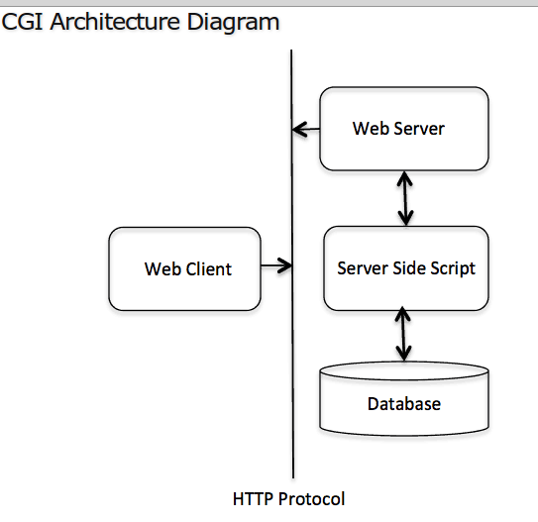

Slide 36
Web Server Support and Configuration
Before you proceed with CGI Programming, make sure that your Web Server supports CGI and it is configured to handle CGI Programs.
All the CGI Programs to be executed by the HTTP server are kept in a pre-configured directory.
This directory is called CGI Directory and by convention it is named as /var/www/cgi-bin.
By convention, CGI files have extension as. cgi, but you can keep your files with python extension .py as well.
By default, the Linux server is configured to run only the scripts in the cgi-bin directory in /var/www.
If you want to specify any other directory to run your CGI scripts, comment the following lines in the httpd.conf file −

Slide 37
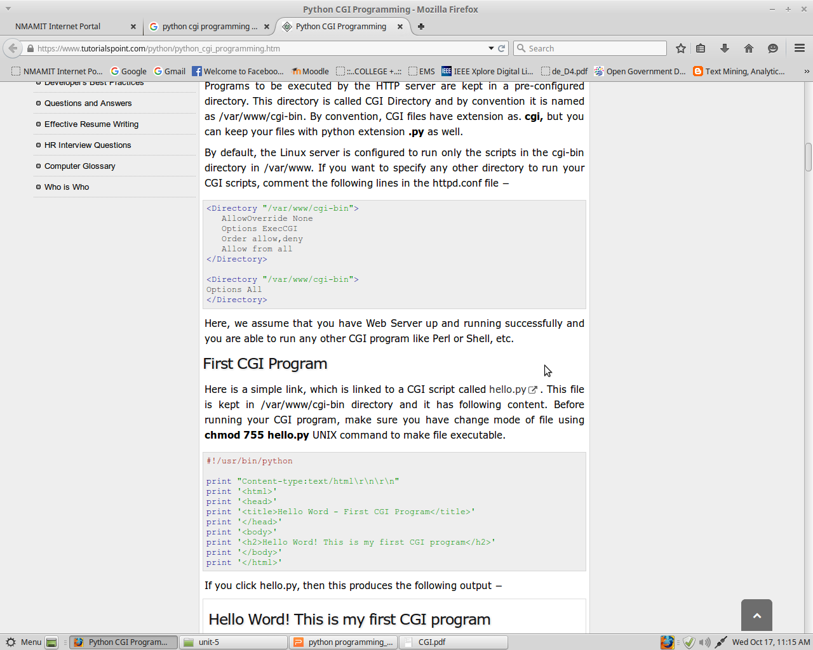

Slide 38
First CGI Program
Here is a simple link, which is linked to a CGI script called hello.py.
This file is kept in /var/www/cgi-bin directory and it has following content.
Before running your CGI program, make sure you have change mode of file using chmod 755 hello.py UNIX command to make file executable.

Slide 39
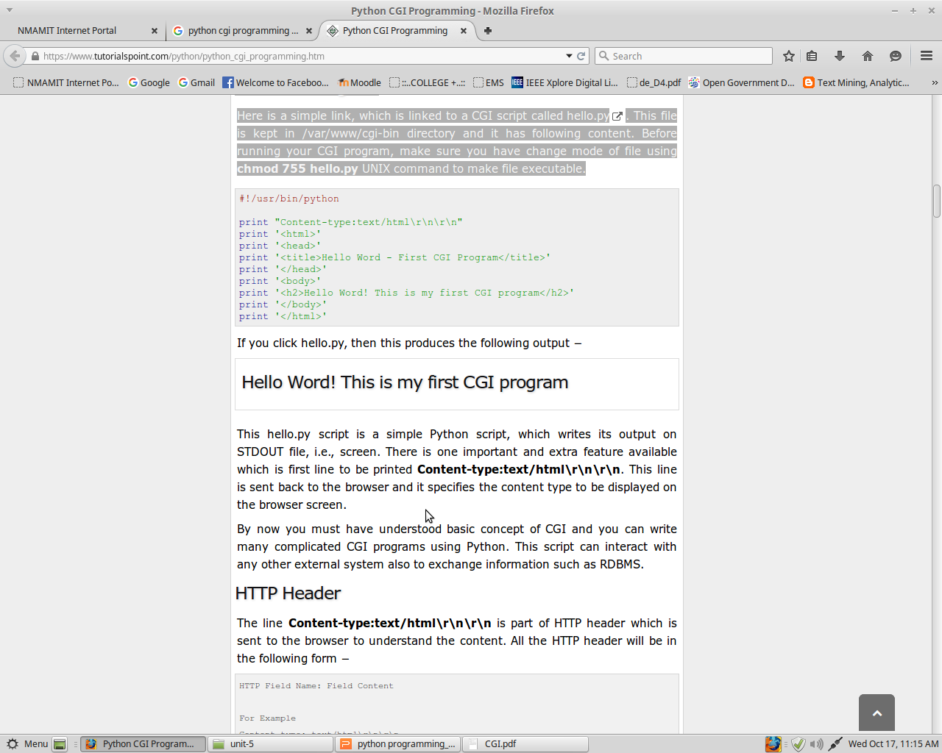

Slide 40
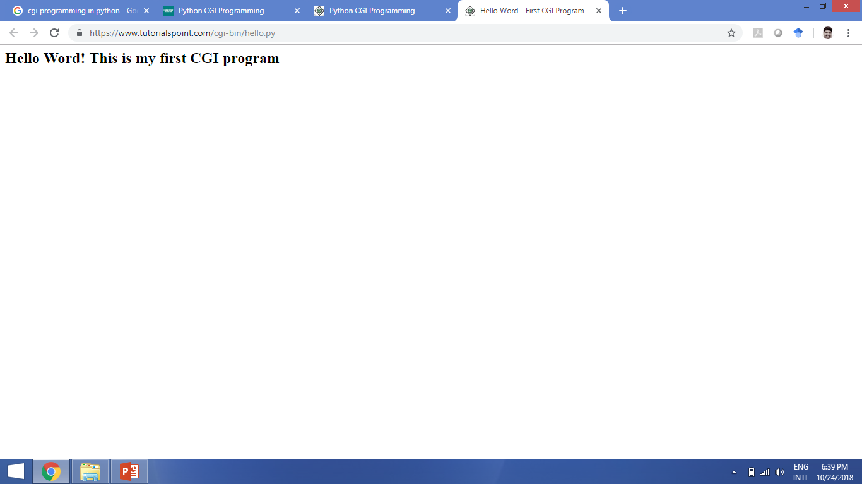
https://www.tutorialspoint.com/cgi-bin/hello.py

Slide 41
This hello.py script is a simple Python script, which writes its output on STDOUT file, i.e., screen.
There is one important and extra feature available which is first line to be printed Content-type:text/html\r\n\r\n.
This line is sent back to the browser and it specifies the content type to be displayed on the browser screen.
you can write many complicated CGI programs using Python. This script can interact with any other external system also to exchange information such as RDBMS.

Slide 42
HTTP Header
The line Content-type:text/html\r\n\r\n is part of HTTP header which is sent to the browser to understand the content.
All the HTTP header will be in the following form −
  HTTP Field Name: Field Content
  For Example
  Content-type: text/html\r\n\r\n
  There are few other important HTTP headers, which you will use frequently in your CGI Programming.

Slide 43
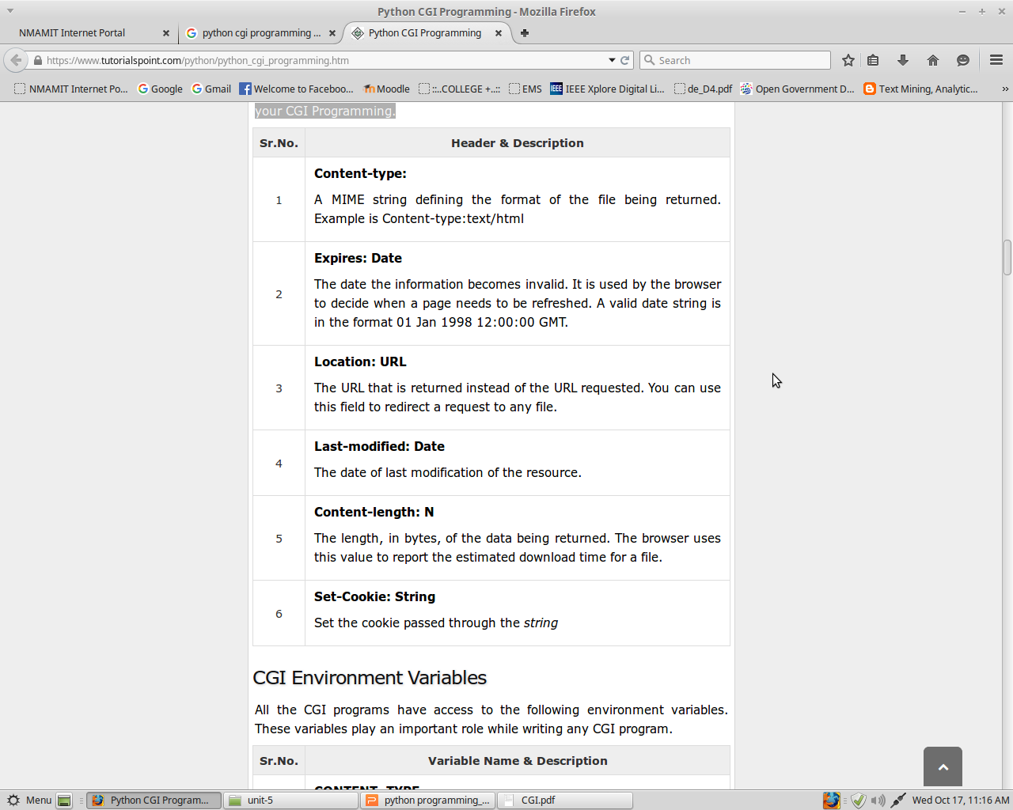

Slide 44
CGI Environment Variables
All the CGI programs have access to the following environment variables.
These variables play an important role while writing any CGI program.

Slide 45
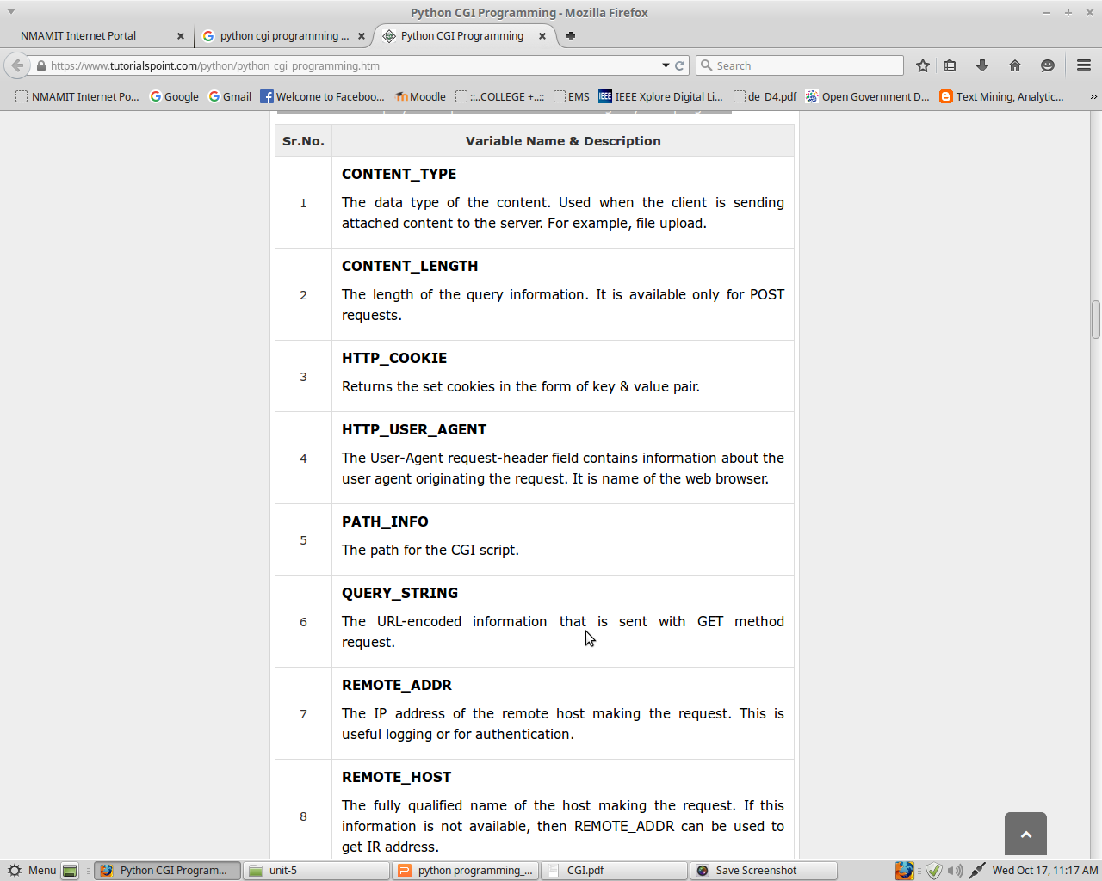

Slide 46
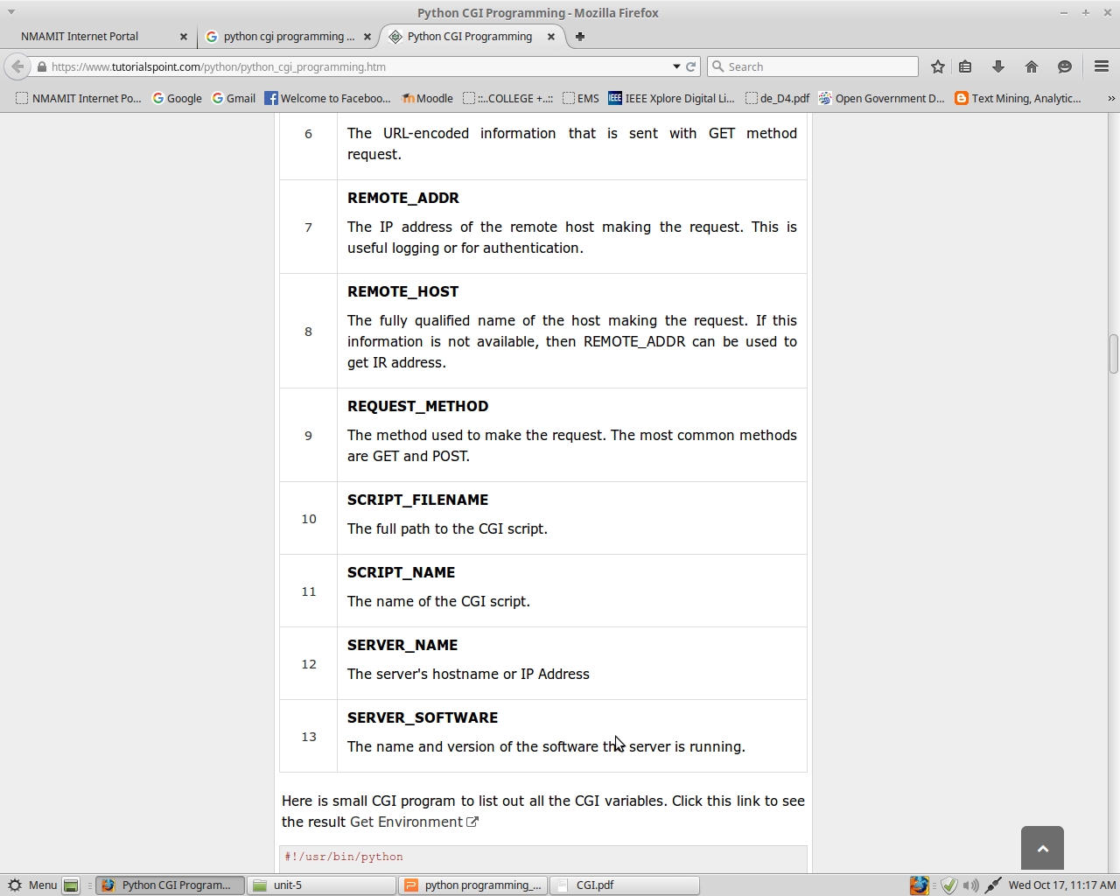

Slide 47
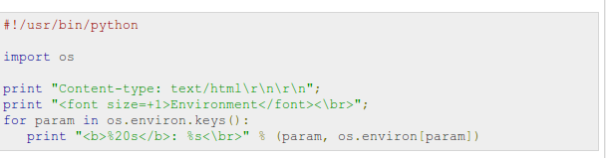
Here is small CGI program to list out all the CGI variables.
Click this link to see the result Get Environment

Slide 48
GET and POST Methods
You must have come across many situations when you need to pass some information from your browser to web server and ultimately to your CGI Program.
Most frequently, browser uses two methods two pass this information to web server.
  These methods are GET Method and POST Method.
Passing Information using GET method
The GET method sends the encoded user information appended to the page request. The page and the encoded information are separated by the ? character as follows −
http://www.test.com/cgi-bin/hello.py?key1=value1&key2=value2

Slide 49
The GET method is the default method to pass information from browser to web server and it produces a long string that appears in your browser's Location:box.
Never use GET method if you have password or other sensitive information to pass to the server.
The GET method has size limitation: only 1024 characters can be sent in a request string.
The GET method sends information using QUERY_STRING header and will be accessible in your CGI Program through QUERY_STRING environment variable.
You can pass information by simply concatenating key and value pairs along with any URL or you can use HTML <FORM> tags to pass information using GET method.

Slide 50
Simple URL Example:Get Method
Here is a simple URL, which passes two values to hello_get.py program using GET method.
/cgi-bin/hello_get.py?first_name=ZARA&last_name=ALI
Below is hello_get.py script to handle input given by web browser.
We are going to use cgi module, which makes it very easy to access passed information −

Slide 51
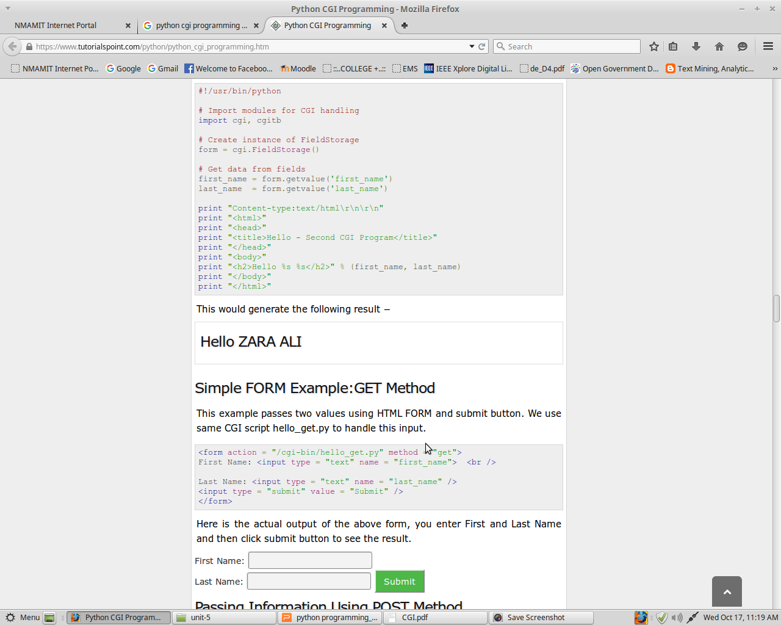

Slide 52
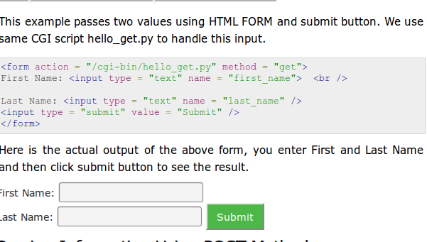
Simple FORM Example:GET Method

Slide 53
Passing Information Using POST Method
A generally more reliable method of passing information to a CGI program is the POST method.
This packages the information in exactly the same way as GET methods, but instead of sending it as a text string after a ? in the URL it sends it as a separate message.
This message comes into the CGI script in the form of the standard input.
Below is same hello_get.py script which handles GET as well as POST method.

Slide 54
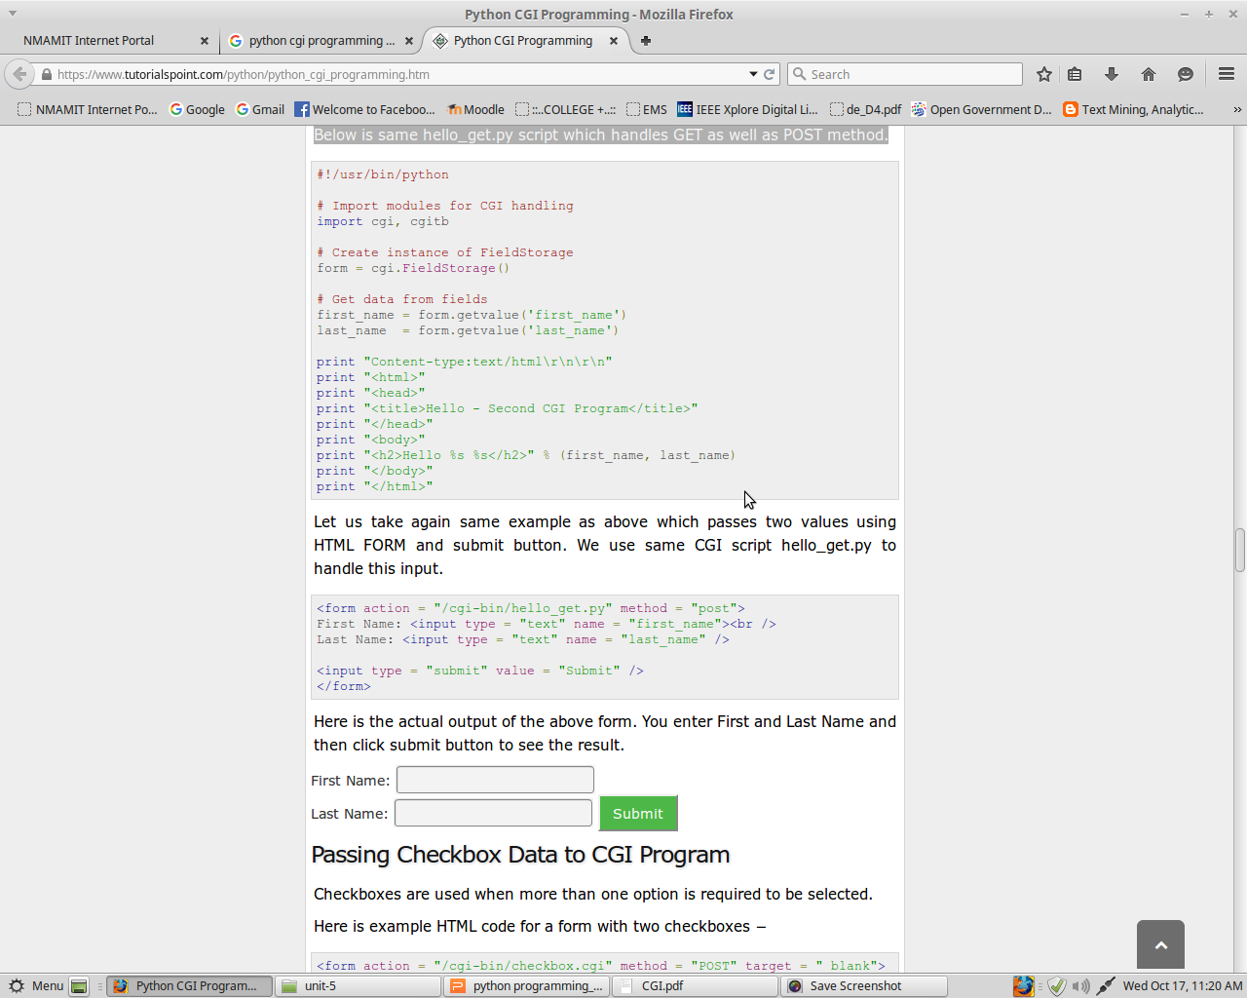

Slide 55
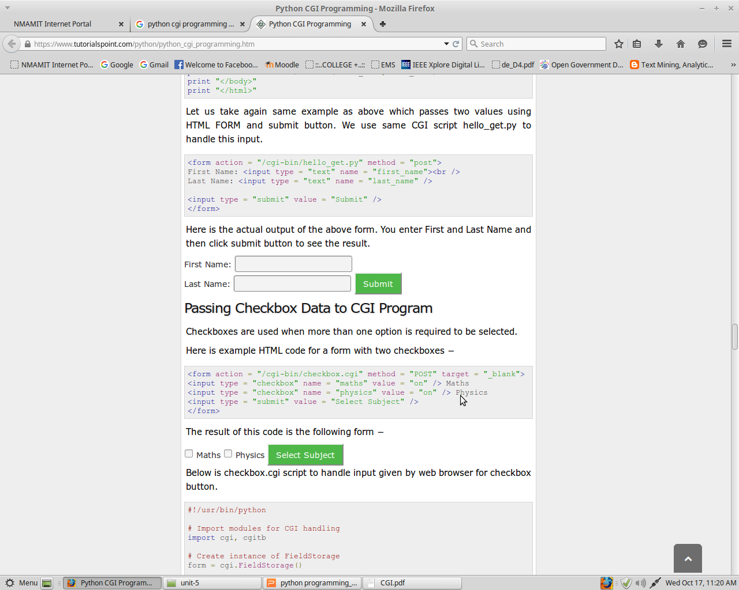

Slide 56
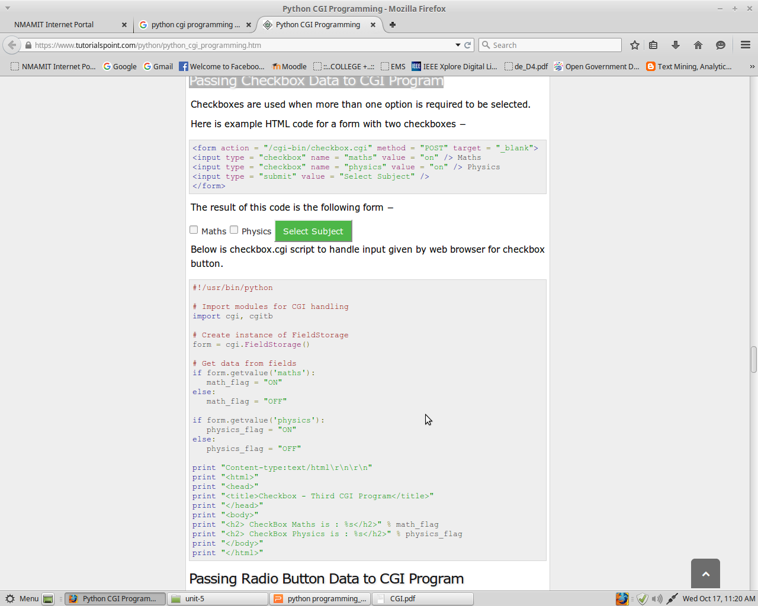
Passing Checkbox Data to CGI Program

Slide 57
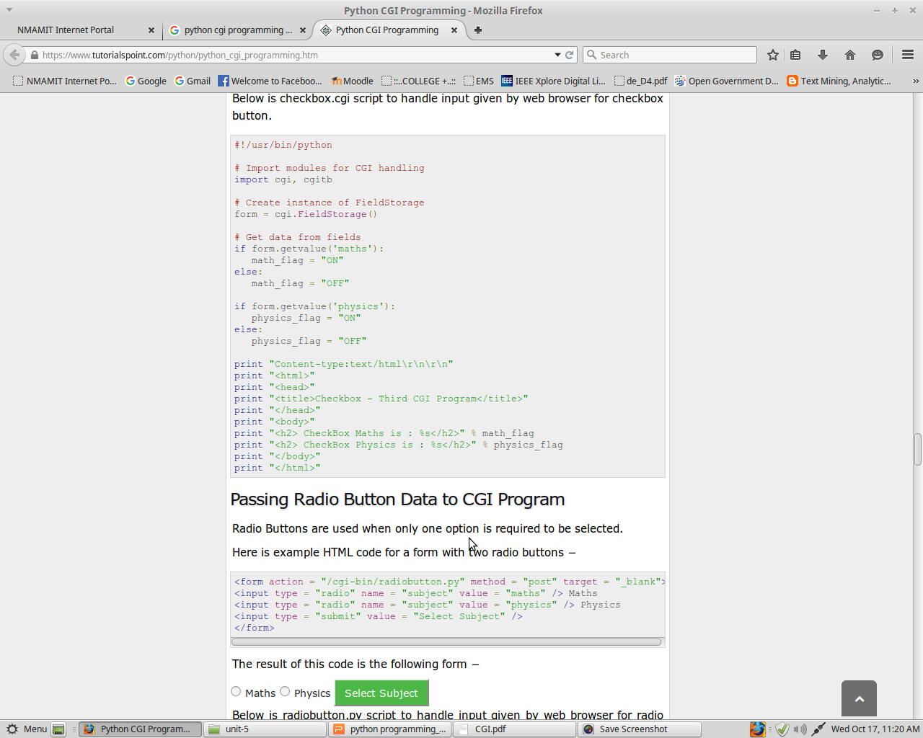

Slide 58
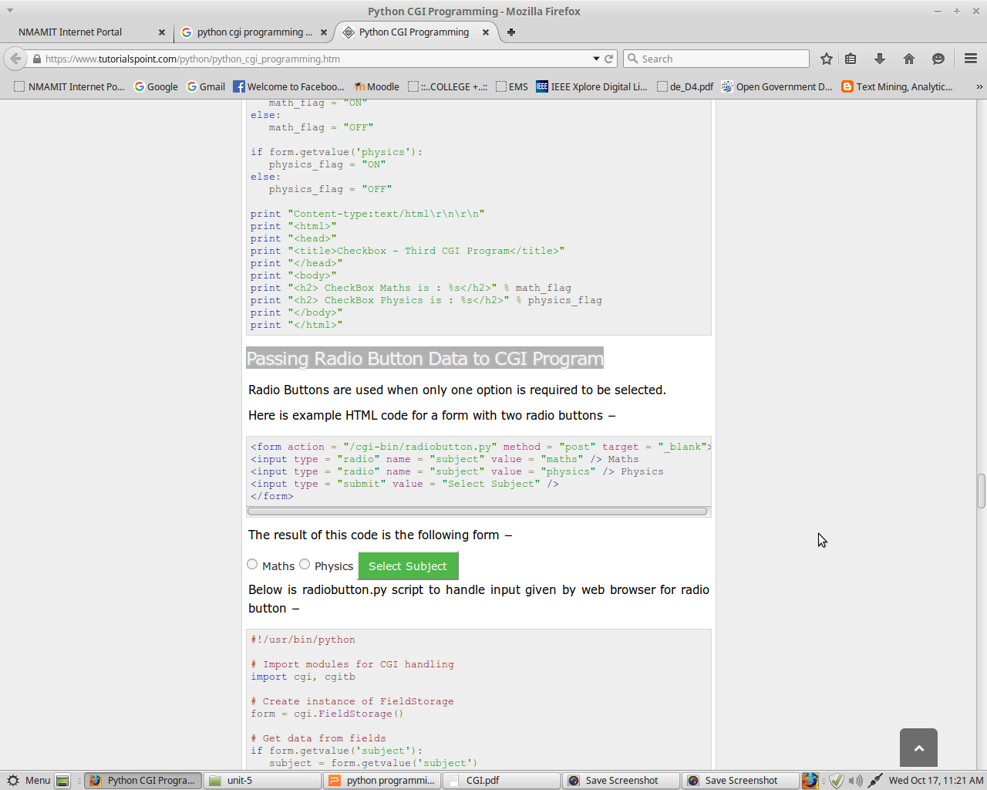
Passing Radio Button Data to CGI Program

Slide 59
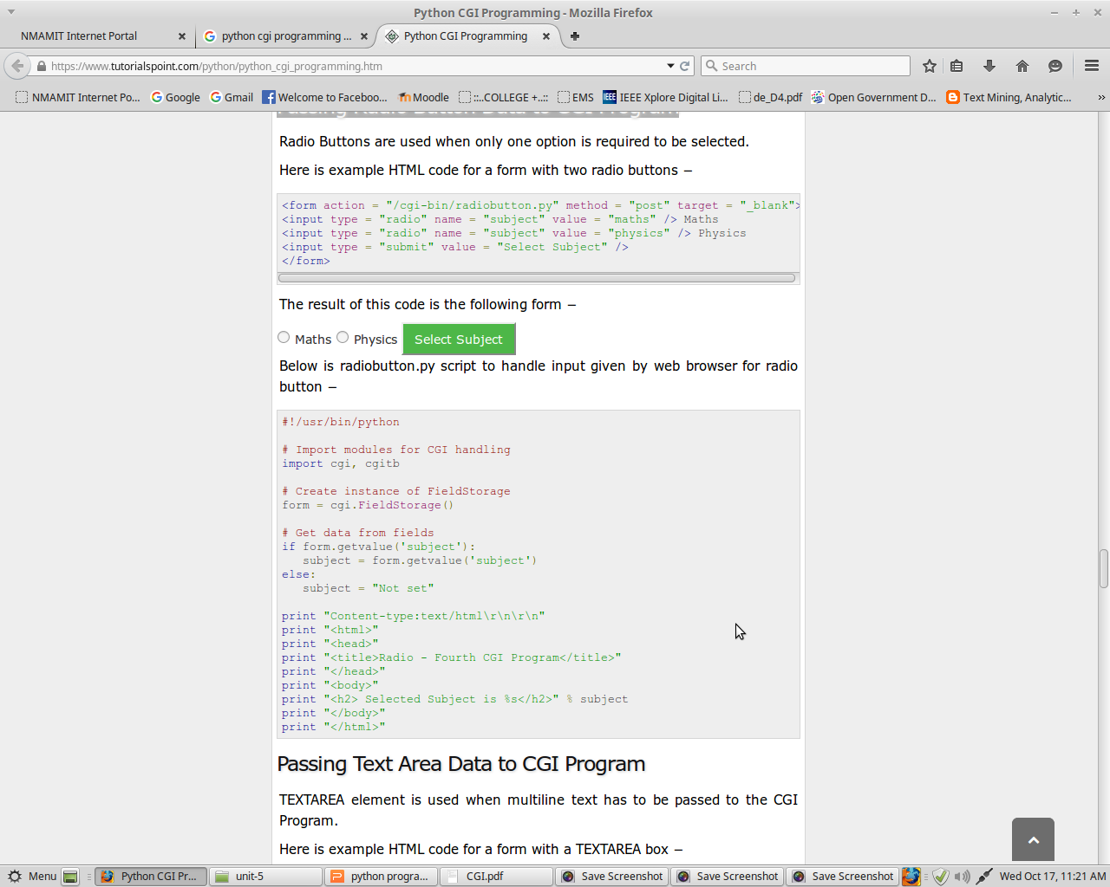

Slide 60
LAB: hello.py
#!/usr/bin/python
print "Content-type:text/html\n"
print '<html>'
print '<head>'
print '<title>Hello Word - First CGI Program</title>'
print '</head>'
print '<body>'
print '<h2> Hello Word! This is my first CGI program </h2>'
print '</body>'
print '</html>'

Slide 61
Execution steps:
nmamit@CSL01_312:~$mkdir cgi-bin
nmamit@CSL01_312:~$cd cgi-bin
nmamit@CSL01_312:~/cgi-bin$gedit hello.py
nmamit@CSL01_312:~/cgi-bin$chmod +x hello.py
nmamit@CSL01_312:~/cgi-bin$cd ..
nmamit@CSL01_312:~$python3 -m http-server --cgi
Open Browser and Type --> localhost:8000/cgi-bin/hello.py

Slide 62
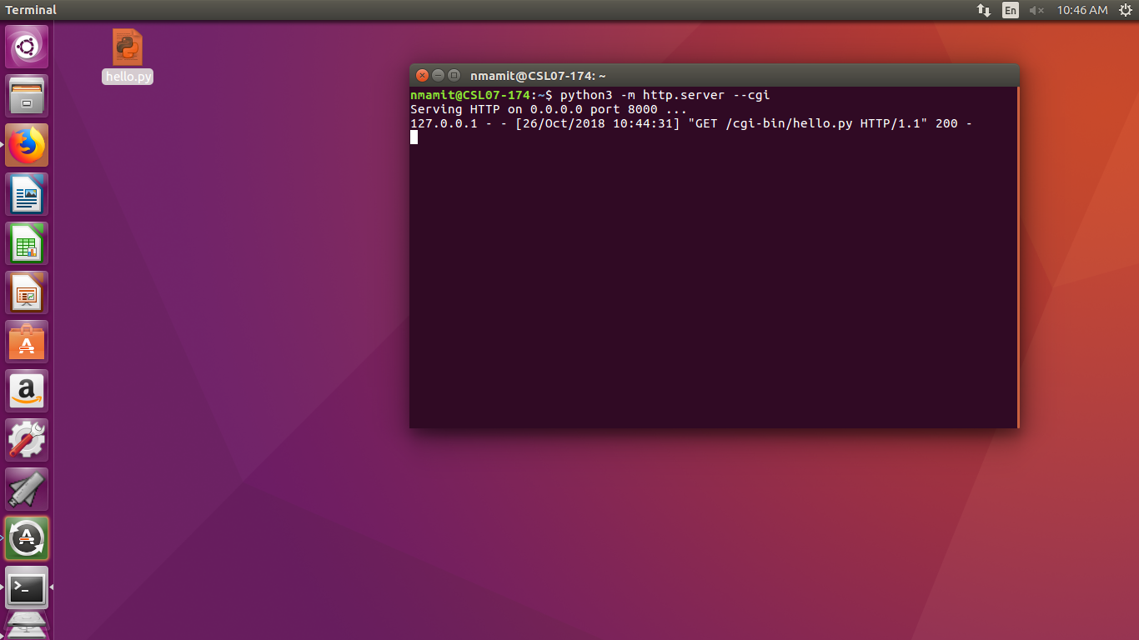

Slide 63
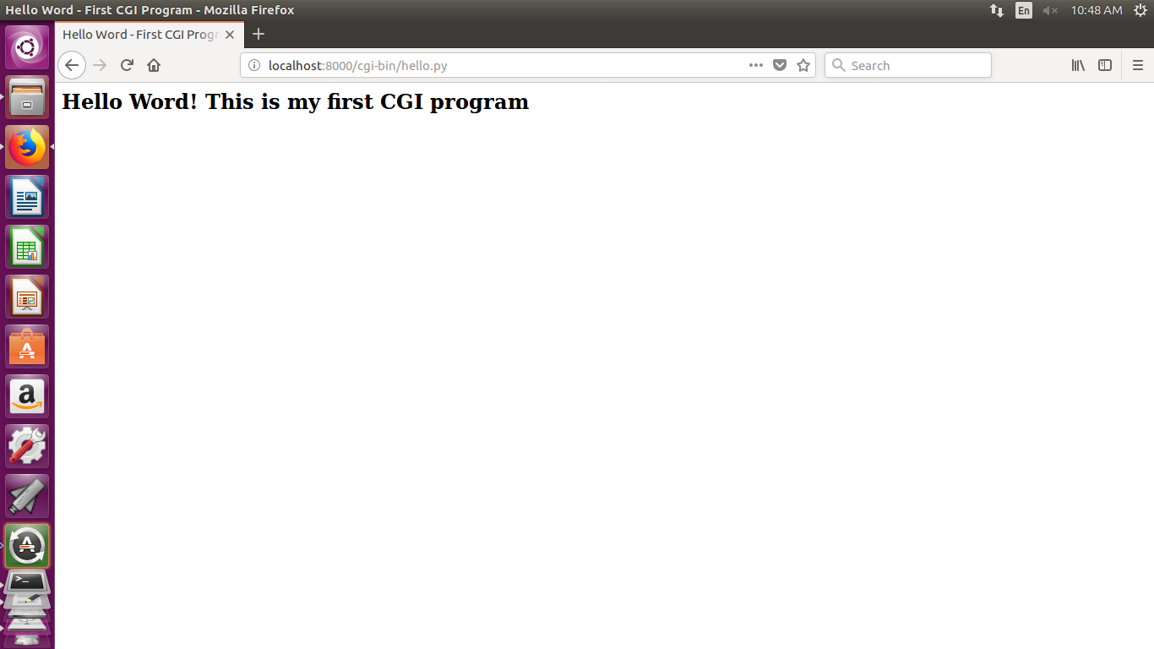
Output

Slide 64
Example:Checkbox
29.html
<html>
<body>
<form action = "cgi-bin/29.py" method = "POST" target = "_blank">
<input type = "checkbox" name = "maths" value = "ON" /> Maths
<input type = "checkbox" name = "physics" value = "ON" /> Physics
<input type = "submit" value = "Select Subject" />
</form>
</body>
</html>

Slide 65
29.py
#!/usr/bin/python
import cgi, cgitb
form = cgi.FieldStorage()
if form.getvalue('maths'):
mflag = "ON"
else:
mflag = "OFF"
if form.getvalue('physics'):
pflag = "ON"
else:
pflag = "OFF"
print "Content-type:text/html \n"
print "<html>"
print "<head>"
print "<title>Checkbox - Third CGI Program</title>"
print "</head>"
print "<body>"
print "<h2> CheckBox Maths is : </h2>" + mflag
print "<h2> CheckBox Physics is : </h2>" + pflag
print "</body>"
print "</html>"

Slide 66
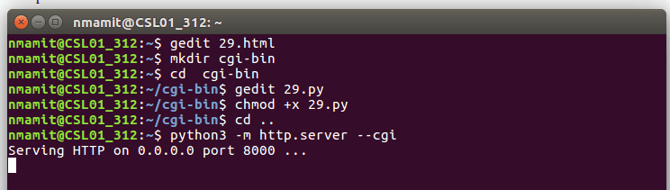
Open Browser and Type --> localhost:8000/29.html

Slide 67
Thank you
Anisha P Rodrigues, DEPT OF CSE

